Slide 1
INTERNSHIP STUDIO INTERNSHIP FOR ETHICAL HACKING TASK – 2 Name – Sovan Das

Slide 2
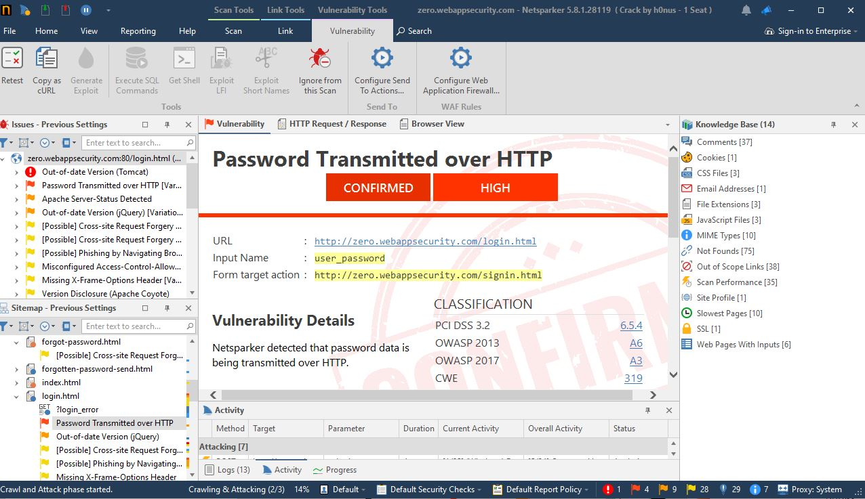
SCREENSHOT

Slide 3
REPORT
VULNERBILITY :
It has been detected that passwords that have been saved are sent over HTTP rather than HTTPS whereas HTTPS is a more secure method

Slide 4
THREAT :
Since it is HTTPS, all the user data that is the password are sent over this protocol, since it in not a secure protocol anyone can hack and penetrate into the network and steal all the credentials which can be used to exploit the user and his data and do malicious acts.

Slide 5
WHAT CAN BE DONE AS SECURITY MEASURES :
All the data (i.e. user credentials , username and passwords) must all be served over an HTTPS network protocol, it is a secure method of network and all data transferred over this network is safe from any attacker or threats.

Slide 6
WHERE THIS THREAT WAS FOUND :
URL :
http://zero.webappsecurity.com/login.html
Input Name : user_password
Form target action :
http://zero.webappsecurity.com/signin.html
HOW IT WAS DETECTED :
It was detected by an well known automatic vulnerability application known as NETSPARKER

